Slide 1

What’s My Business Model?
How will your organization create, deliver and capture value?
Material in this workshop adapted from Babson College and Osterwalder & Pigneur, Business Model Generation. URL: http://www.businessmodelgeneration.com/book

Slide 2
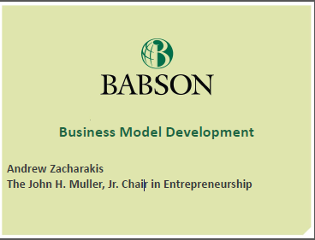

Slide 3
Agenda
What is a “business model”?
Examples: you know more than you think about business models!
The business model canvas
Looking for revenue models
Another example: Revenue models for a lemonade stand
Your “big idea” – revenues and costs
Using the business model canvas to flesh out your team’s business model
Questions and wrap-up

Slide 4
What’s My Business Model?
Answer these three questions to identify the elements of an organization’s business model:
  Who is your customer (client, donor, user, etc.)?
  What does your customer value?
  How will your organization remain economically viable?

Slide 5
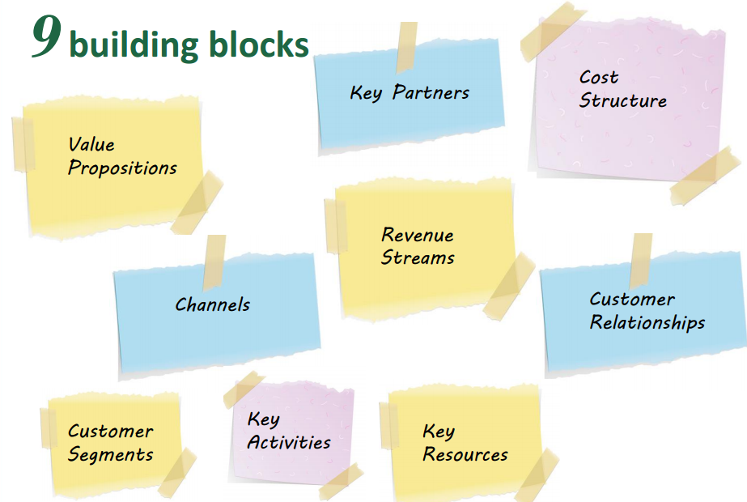
Visualizing Your Business Model (Strategyzer and Kaufmann Foundation)

Slide 6

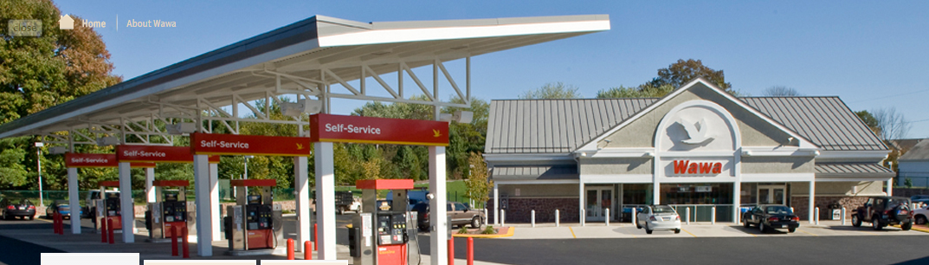

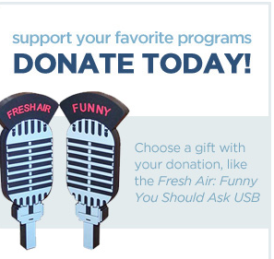
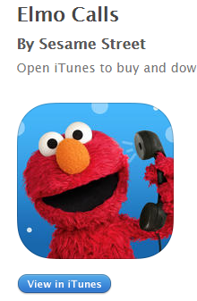




Slide 7
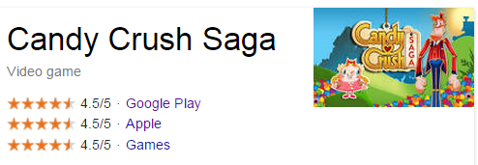

Parents, Grandparents…Kids
Entertainment, distraction, social interaction skills
App purchases
In-app purchases
App enhancements

Slide 8
Customers, Value and Economics
WHYY
Listeners & Viewers
Programming with a difference
Donors & sponsors (one-time and recurring)
Ursinus College
Students, parents, alums, employers
Quality residential liberal arts education
Tuition, donations, grants, government, foundations, etc.

Slide 9
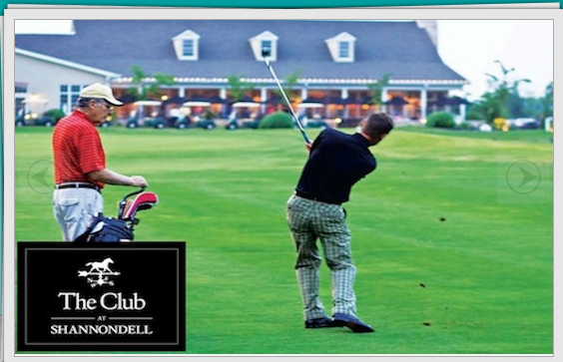
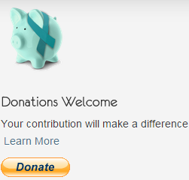
Support for finding a cure for ovarian cancer.
Annual major golf tournament
People who knew Michele or know her family or story or those touched by ovarian cancer.

Slide 10
Netflix And Redbox:
Two Contrasting Business Models
 | Netflix | Redbox
Value Proposition | Convenient delivery of movies to customers’ mailboxes or streamed to their PCs, Macs, or TVs. | Economical 24-hour movie rentals and purchases that could be picked up at conveniently located DVD kiosks.
Profit Formula | Revenue Generation: Monthly subscription fees from millions of subscribers Cost structure: Fixed and variable costs associated with DVD acquisitions, licensing fees and revenue sharing agreements, development of movie selection software, website operation and maintenance, Internet streaming capabilities, distribution center operations, and administrative activities. Profit Margin: Netflix’s profitability was dependent on attracting a sufficiently large number of subscribers to cover its costs and provide for attractive profits. | Revenue Generation: Customers could rent DVDs and purchase DVDs from Redbox’s DVD vending machine kiosks. Cost Structure: Fixed and variable costs associated with the kiosk purchases and deployment, DVD acquisitions, licensing fees and revenue sharing agreements, website operation and maintenance, kiosk stocking, and administrative activities. Profit Margin: Redbox’s profitability was dependent on generating sufficient revenues from DVD rentals and sales to cover costs and provide for a healthy bottom line.

Slide 11
Wawa: Who and What?
Wawa’s business model is built around a commitment to providing individual and institutional customers (WHO) with exceptional service and a convenient source of fresh foods, high quality gasoline, and other consumable products in locations that are easily accessible and extraordinarily clean (WHAT).

Slide 12
Wawa: Profit Formula
Use of the latest technology to achieve efficiencies in production and purchasing distribution, marketing and store management drives down costs while convenience, quality, freshness and service support attractive margins. This commitment to freshness, quality, service and convenience in standardized store formats will attract a loyal clientele that visits day after day making multiple purchases.

Slide 13
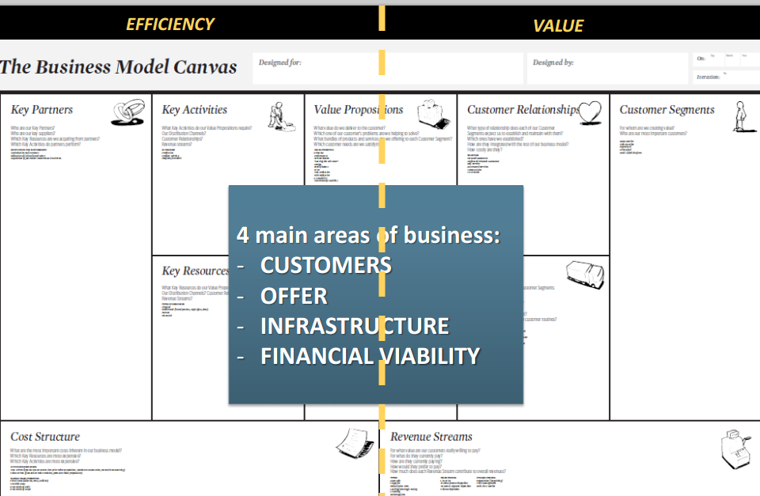

Slide 14
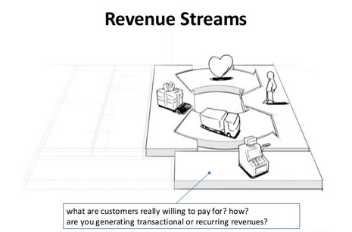

Slide 15
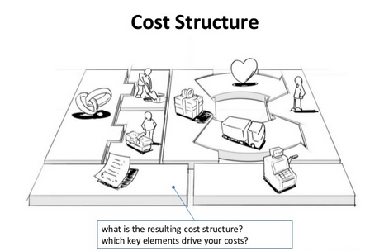

Slide 16
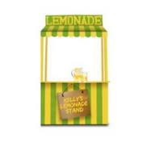

Slide 17
Revenue Models: Lemonade Stand
Model | Description
Unit Sales | Sell a product or service to customers.
Advertising Fees | Sell opportunities to distribute messages.
Franchise Fees | Sell and support a replicable business for others to invest in, grow and manage locally.
Utility Fees | Sell goods and services on a per-use or as-consumed basis.
Subscription Fees | Charge a fixed price for access to your services for a period of time or series of uses.
Transaction Fees | Charge a fee for referring, enabling, or executing a transaction between parties.
Professional Fees | Provide professional services on a time-and-materials contract.
License Fees | Sell the rights to use intellectual property.
Adapted from Jump Associates and A. Zacharakis, Price-Babson Symposium 2014.

Slide 18
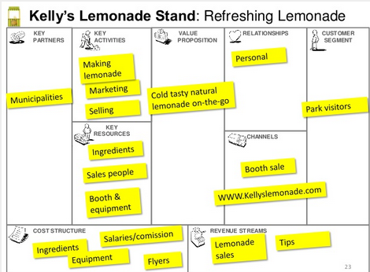

Slide 19
Your Revenues and Costs
How will you obtain the funds to support your operations (so you can continue to deliver value to your customers)?
Where do your costs come from?
  Fixed costs?
  Variable costs?
Who will do the work?
How will you communicate your value?
Get materials?
Conduct operations?
Stay current with technology?
Take 10 – Answer these questions for your “big idea”

Slide 20
Using the business model canvas as a guide for developing your “big idea”

Slide 21
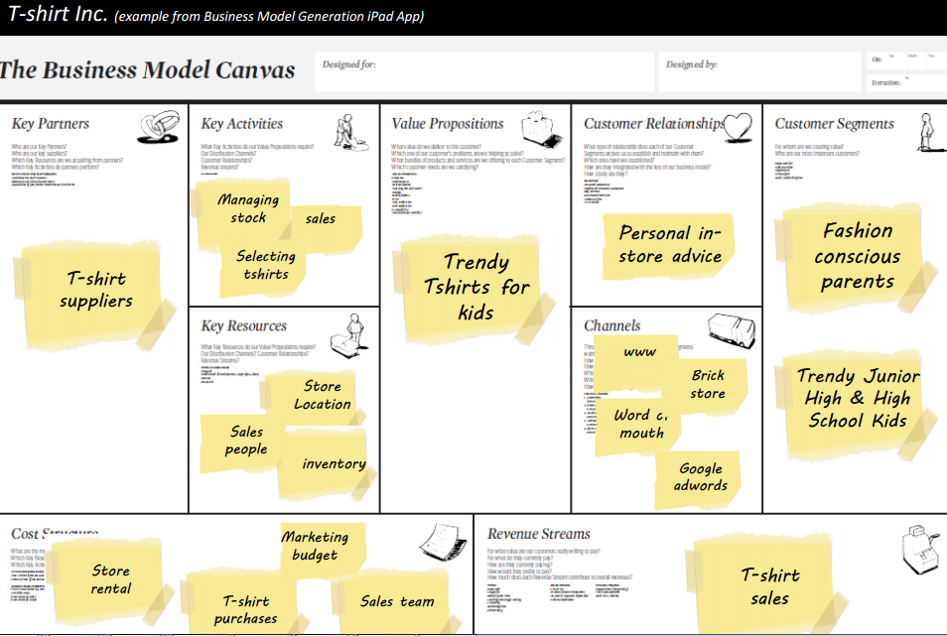

Slide 22

Business Model South Africa WC 2010
KEY
PARTNERS
KEY
ACTIVITIES
OFFER
CUSTOMER RELATIONSHIPS
CUSTOMER
SEGMENTS
Soccer
”live”
in stadium
Organization
and safety
Visitors*
(local)
FIFA
Ticket
sales
“We love soccer”
Soccer
Games
On site
Merchandise
“vuvuzela”
Visitors
(global)
SA
Government
KEY
RESOURCES
CHANNELS
TV viewers
(global)
Transportation
Food
Hotels
Tourism
“welcome to SA”
Facilities
TV
Brand!
FIFA.com
Soccer players
Stadiums
Broadcast venues
(pubs, resto’s)
Soccer
teams
Other facilities
Local
Advertisers
COST STRUCTURE
REVENUE STREAMS
Safety
People
Merchandise
Rev share/
License FIFA
Event
Ticket sales
Infra
Host compensation
FIFA
Retail
(goods, food, hotels)
22

Slide 23
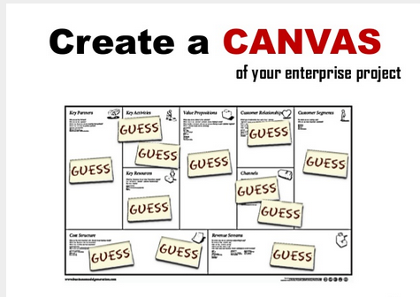

Slide 24
Use Available Resources!
Capture Your Business Model in 20 Minutes!
Companion website: www.leanstack.com
As a team, watch the video and complete your business model canvas in 20 minutes!
  HINT: Set up a free account (for 30 days) at leanstack.com before you start the video

Slide 25
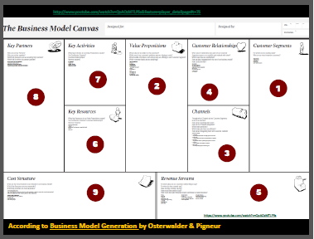

Slide 26
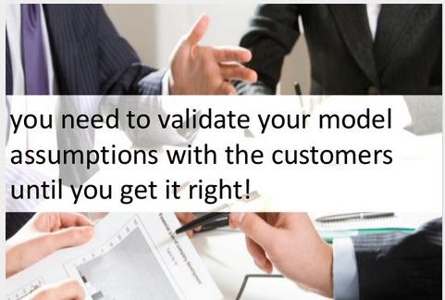
Smart Advice - Listen Up! (Good advice, no pizzazz!)

