Slide 1


Experimenting With Voice
Center for Writing and Speaking
Annalise Koup and Talia Argondezzi
To hear audio, click the speaker icon

Slide 2

What is voice?
Voice is what makes your writing style distinct from other people’s
It is the way a writer sees the world, and how they translate it into words
Voice gives life to writing; without voice, writing is dry and void of meaning
Notes:
What is voice? Voice is what makes your writing style distinct from other people’s- no one else can replicate it. It is the way you see the world and communicate your thoughts on paper. Without voice, writing can be dry and hard to understand. If this concept is still confusing to you, you can think of voice as how you speak verbally. What does the inflection in your voice communicate? Do you speak quickly or slowly? How does your telling of events differ from the way a friend describes the same event?

Slide 3
What makes up voice?
Voice contains many components of writing, including diction, imagery, syntax, tone, level of formality, and rhythm. In short, voice contains all the elements of writing that make it unique to you.
    Diction involves word choice
    Syntax is the way you arrange words. This can include sentence length, word order, and punctuation
    Tone involves what emotions come across to readers in a piece of writing. This is established through all areas of writing, including syntax, diction, imagery, etc.
Notes:
What makes up voice? Voice contains many components of writing, including diction, imagery, syntax, tone, level of formality, and rhythm. In short, voice contains all the elements of writing that make it unique to you. Some of these words may be confusing, so here are the definitions of the more complex terms. We will discuss each of these terms in length later in this presentation.

Slide 4
Why does voice matter?
It allows you to engage with your audience by giving an impression of yourself or your perspective on the topic in your writing
It conveys the message to your audience more effectively
It makes your writing more interesting! Without a voice, writing can mimic the style of a boring instruction manual. The best pieces of writing always include personality!
Notes:
So, why should we experiment with voice at all? A lot of people assume that academic writing should be dull, flat, and indistinguishable from everybody else’s writing. While sometimes that is the case depending on what genre you’re writing in, more often than not, your audience needs more engagement to follow along with what you are saying. Voice helps with engagement by highlighting your perspective on the topic and your personality. Adding voice to your academic writing can also help convey your message more effectively to your audience. Finally, adding personality through voice makes your writing much more interesting, and your readers will want to keep reading!

Slide 5

Now that we know what voice is, how do you find your voice?

Slide 6

Step 1: Consider Genre
What is the genre or setting of your writing?
  Is it a scholarly research paper? A letter? A social media post?
What level of formality might be expected in that genre?
  Is it formal for a scholarly paper? Informal for a friendly letter? Colloquial for a social media post?
Will you conform to those expectations, or strategically subvert them?
Notes:
Step 1: Consider genre. What kind of writing are you starting? Is it an academic paper that may require more formality, or a prompt that may require you to write a letter to a friend? Either way, it is first important to establish formality in order to guide the voice you will have. Then, consider if you will conform to those expectations or subvert them. For example, a speech may be written more formally or informally depending on your topic. Argumentative speeches tend to be less formal, while informational speeches tend to be more formal.

Slide 7
Step 2: Be Deliberate About Tone
Remember, tone conveys the mood of your writing and the attitude you have towards your topic and audience.
With your genre and preferred level of formality in mind, consider your purpose for writing. What tone would best match that purpose?
Is it a distant and objective tone for a scholarly paper meant to inform the audience?
Emotional yet formal for a speech?
Humorous and casual for a letter or media post?
In addition, what mood are you aiming for?
Happy? Mournful? Angry? Urgent?
Notes:
Step 2: be deliberate about tone. Tone can be defined as the mood of a piece of writing and the attitude a writer has towards their topic and audience. To decide what tone your writing should take, consider your genre and preferred level of formality. For instance, a distant and objective tone may work well for a scholarly article, while an argumentative speech may involve more emotion as an argumentative tactic.

Slide 8

Step 3: Diction, or Word Choice
Think of your audience. A letter has a much different audience than an academic paper, and you must match the level of technicality to your audience’s level of understanding.
What level of colloquial, informal, and slang words should you use? For instance, contractions may be appropriate for a letter, but not some academic articles.
Think of the connotation of words (e.g. frugal vs. cheap)
Notes:
Step 3: Diction, or word choice. When deciding what kind of tone is appropriate for your piece of writing, consider your audience. If you are writing an academic article, you can include more technical terms and vocabulary than you would in a letter to your grandparent. Next, you want to decide what level of colloquial, informal, and slang words you will use. The genre of your writing will help you decide what level of informality is appropriate. Finally, we want to think of the connotation of the words we use. Connotation is how we generally perceive a word to be negative or positive. For instance, being called frugal may be a positive thing while being called cheap is more of an insult.

Slide 9
Step 3: Diction, Continued
Cliches
Hedging (e.g. I think, maybe, seemed)
Detail
Inclusive language (use “humankind” instead of “mankind”, “people with disabilities” instead of “disabled people”)
Notes:
This slide contains diction advice that you should almost always follow, regardless of formality level. First, avoid clichés. Clichés are phrases that are common in daily speech, such as commenting that someone is “as sharp as a tack.” We want to avoid them because they are overused, and we want to be more creative in our expressions. Second, avoid using hedging words in most cases. Instead of saying ”I think this essay is good,” just say “this essay is good.” Removing hedging words makes you sound much more confident and assertive in your arguments. The only exception to this rule is if there comes a point in your essay where you truly don’t know if something is true. Next, use more detailed writing. For instance, instead of writing that someone is a renowned writer, provide more detail and write that they are a 1989 Nobel Prize Winner. Lastly, use inclusive language in your writing. Instead of using ”man” as the default gender, say humankind instead of mankind. The second example illustrates that people with disabilities are not defined by their disability, but rather, their personhood is established first.

Slide 10
A Few Principles for Inclusive Language
Be mindful and considerate
Look it up!
If you make a mistake, briefly apologize and move on
Inclusive language resources:
    https://online.rider.edu/online-bachelors-degrees/liberal-studies/guide-to-using-inclusive-language/
    https://studentaffairs.fiu.edu/get-involved/social-justice-and-inclusion/inclusive-language-guide/_assets/inclusive-language-guide.pdf
Notes:
It can be difficult sometimes to know if you are using inclusive language or not, so keep the following three principles in mind. First, just make an effort by being mindful and considerate. Make sure you are deliberate in the language you use to make sure you are not excluding a person or group. If you are not sure of the correct term to use, just look it up! It takes a minute to prevent hurting anyone by just looking it up to make sure you are using inclusive language. Lastly, it’s okay to make mistakes. You may have the best intentions but still use the wrong language. Briefly apologize, avoid getting defensive, and learn from your mistakes! At the bottom of the slide, you can find some inclusive language resources to reference later on.

Slide 11
Step 4: Be Deliberate in Syntax and Punctuation
Syntax, or the way you arrange words, can change how easy writing flows. Sentence length, word order, and punctuation are all components of syntax.
Tip 1: Vary sentence length! Using too many long sentences can be difficult to follow while using too many short sentences makes writing choppy. The best practice is mixing it up and using both.
Tip 2: Avoid passive voice.
    Active: “The student wrote the essay”
    Passive: “The essay was written by the student”
Notes:
Syntax refers to the way you arrange words. Sentence length, word order, and punctuation are all components that can change how easy writing flows while reading. In order to improve the flow of your writing, first be deliberate in choosing sentence lengths. Using too many long sentences often leads to readers feeling exhausted and lost trying to figure out your main idea. Meanwhile, using only short sentences can negatively impact the flow of your writing. The best practice is using a mix of both lengths to keep your writing interesting. You can also determine what sentence length to use by considering the emotion you are trying to convey. Short sentences are effective at conveying anger, shock, danger, or merely grabbing your readers’ attention. Tip 2, avoid passive voice. Passive voice can make your writing seem stilted and difficult to understand. Active voice leads to better comprehension. As you can see in the example, the sentence the student wrote the essay is much clearer than the essay was written by the student.

Slide 12
A Guide to Punctuation
 | Colon : | Semi-Colon ; | Em Dash –
When to use | used for introducing lists, for emphasis, or between independent clauses when the second explains the first. | used between independent clauses when a coordinating conjunction is omitted. This rule is demonstrated below. The bold shows the difference between the two sentences. | The em dash ( — ) is versatile. It can be used in place of commas, parentheses, or colons. Dashes are more emphatic than commas and should be used sparingly.
Example | “All three of their children are involved in the arts: Richard is a sculptor, John is an actor, and Julie is a pianist.” “You can see why I never go to that restaurant: every day, there’s a line out the door.” | “The upperclassmen are permitted off-campus lunch; the underclassmen must remain on campus.” “The upperclassmen are permitted off-campus lunch, but the underclassmen must remain on campus.” | ”When the car was finally delivered, nearly three months after it was ordered, she decided she no longer wanted it.” ”When the car was finally delivered—nearly three months after it was ordered—she decided she no longer wanted it.”
thepunctuationguide.com
Notes:
While punctuation is often overlooked, it is an important tool that can make a good essay into a great essay. It can be difficult knowing what punctuation to use in different circumstances, so this chart shows how to use a few of the most misused punctuation marks. For more help and how to use other punctuation marks, thepunctuationguide.com is a great resource!

Slide 13
Embracing Your Voice
Should you ever break away from formal academic English, even in traditionally formal genres? Probably!
To make a point or for dramatic effect, “standard” academic English can often be set aside in favor of a style that reflects your perspective.
  For example: Vershawn Ashanti Young’s scholarly article “Should Writers Use They Own English?” argues that the use of dialects should not be suppressed, even in formal writing. Here’s an excerpt:
    “But dont nobody’s language, dialect, or style make them ‘vulnerable to prejudice.’ It’s ATTITUDES. It be the way folks with some power perceive other people’s language” (Young 110).
Notes:
While we have reviewed the components of voice and how to develop it, a lingering question may be if we should ever break away from formal academic English, even in traditional forms like academic writing. While a difficult question to answer, probably! Breaking the so-called standards of a genre of writing can be very impactful. Vershawn Ashanti Young’s scholarly article “Should Writers Use They Own Engish?” is a perfect example of how impactful breaking writing conventions can be. He argues that writers should use their own dialect even in formal writing, which he demonstrates throughout his entire article. The excerpt at the end shows the style of writing in the essay, and it is especially effective because it strengthens his argument. So, experimenting with voice can add complexity and interest to your writing and actually strengthen the validity of your argument.

Slide 14
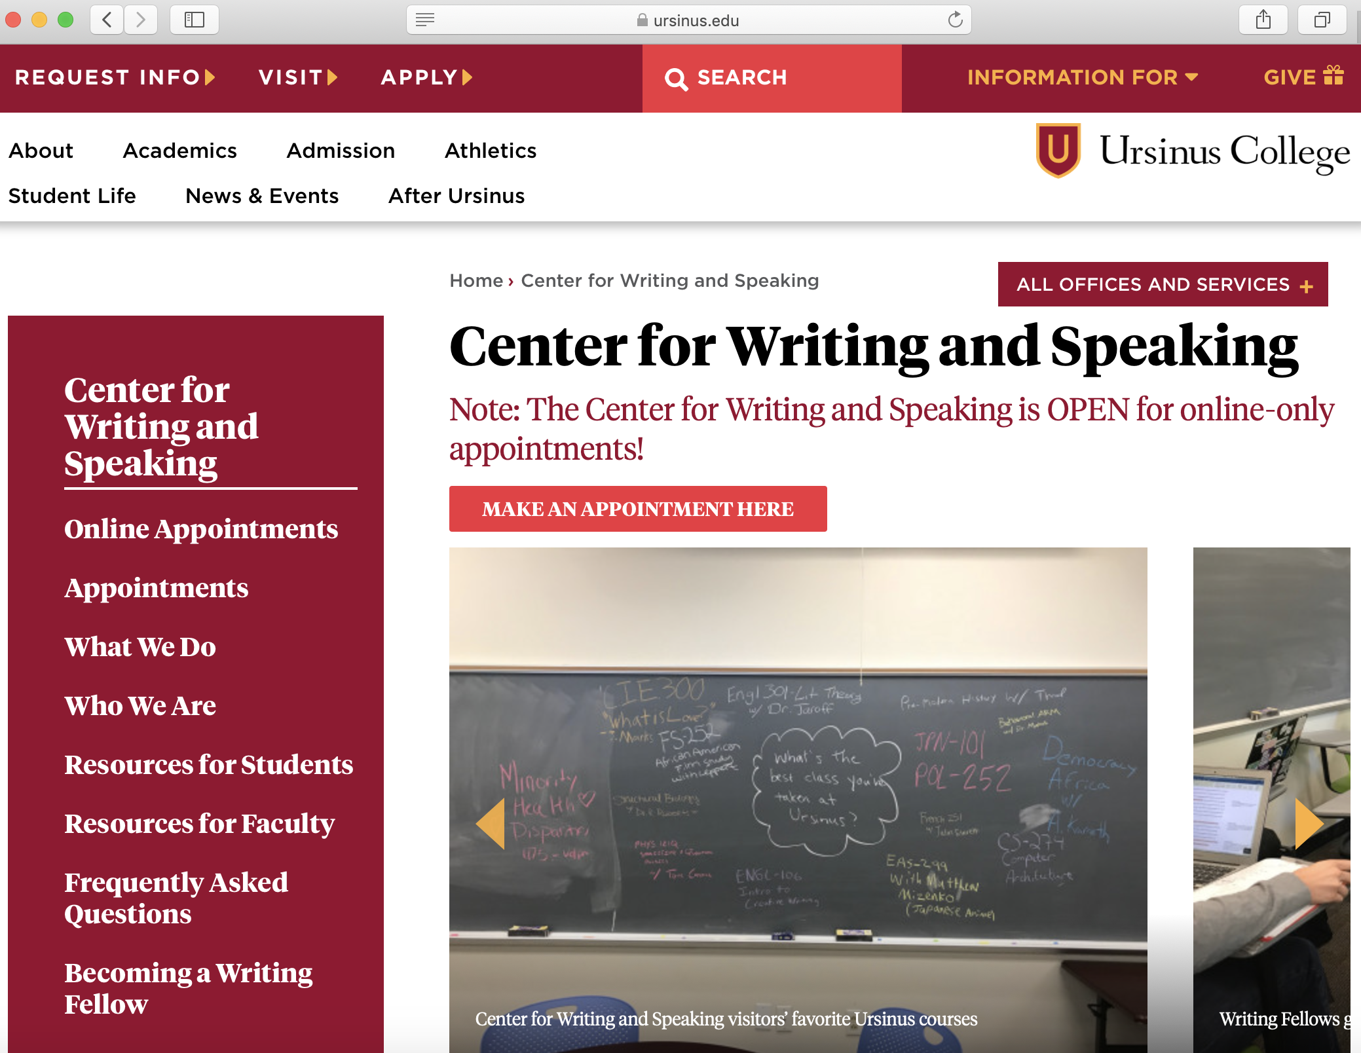
If you need more help, please make an appointment at the Center for Writing and Speaking! We’d love to see you ☺
https://www.ursinus.edu/offices/center-for-writing-and-speaking/

Slide 15
Sources
Everyone’s An Author: With Readings by Andrea Lunsford et al. New York: Norton, 2016.
https://www.wheaton.edu/academics/services/writing-center/writing-resources/style-diction-tone-and-voice/
https://www.helpingwritersbecomeauthors.com/most-common-mistakes-series-why-vague/
https://buffer.com/resources/inclusive-language-tech/
https://www.masterclass.com/articles/what-is-diction-learn-8-different-types-of-diction-in-writing-with-examples#8-different-types-of-diction-in-writing
“Should Writers Use They Own English?” by Vershawn Ashanti Young, in the Iowa Journal of Cultural Studies, vol. 12, issue 1, 2010.
https://www.thepunctuationguide.com/em-dash.html
https://blog.carlow.edu/2021/07/19/how-to-develop-your-writing-voice/
https://writingcooperative.com/the-writers-voice-what-is-and-how-to-find-yours-ed82f1884984

