Slide 1

Strategies and Templates for Building a Strong Thesis Statement
By Talia Argondezzi, Annalise Koup, and Carver Wolfe
To listen to audio explanations, click the speaker icon in the lower right corner of each slide.

Slide 2
Strategies for Infusing Your Thesis Statement with Insight

Slide 3
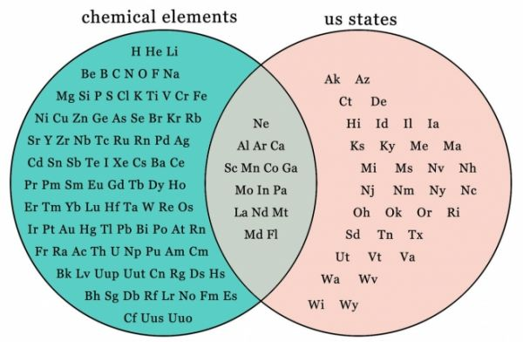
Insight Strategy
Point out a similarity between two things that seem really different at first.
As a small suburban liberal arts college, Ursinus would appear to have little in common with Columbia University, with its large population, urban campus, and international reputation. But their shared interest in a common “Great Works” course taken by all freshmen is the cause of the tightknit communities at both schools.
Although Allegory of the Cave takes place in ancient Greece and Persepolis takes place in modern Iran, both settings display the harmful effects of a dictatorial society.

Slide 4
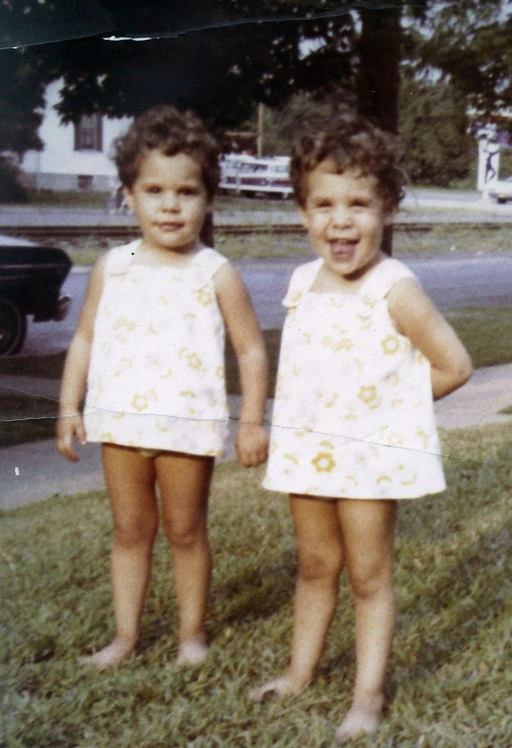
Insight Strategy
Point out a key difference between things that seems similar.
Both Gene and Laura are professors who teach two classes per semester, but because Laura’s two classes have 50 students each and are writing intensive, her workload is substantially heavier.
Although Medea and Sappho are both victims of their respective patriarchal societies, Medea clings to her marriage with Jason, whereas Sappho rejects the concept of marriage altogether.

Slide 5
Insight Strategy
Point out an underlying assumption or unproven premise.
The argument that women are simply “programmed” to nurture their children is based on biology alone and neglects the fact that human behavior is socially constructed.
Those who would call Medea insane overlook her lack of options. Euripides’s audience would know that any of the “sane” measures today’s woman might take were unavailable to Medea.

Slide 6

Insight Strategy
Point out something that is true and accurate, but that others would not necessarily think of.
Seek ideas that are not immediately apparent, but only emerge after deeper reflection.
While Judy seems to be a mindless “yes” person, simply constantly agreeing with everyone, she subtly interjects dissent and disagreement when she hesitates before she agrees.
Although Medea appears to be a feminist icon, she is actually motivated by self-interest rather than female empowerment since she murders the princess for daring to steal her husband.

Slide 7
Thesis Statement Templates

Slide 8
Pattern 1: Meaning of the Evidence
Through the negative reaction of the man leaving the cave, Plato’s Allegory of the Cave shows that acceptance of the truth can be painful at first, and some may even reject it in favor of the reality they are more comfortable with, even if they know it is false.
The template:
Through [evidence], [text] shows/demonstrates [significance].

Slide 9
Pattern 2: Significance of the Claim
Through the reactions of the prisoners to the escaped man, Plato’s Allegory of the Cave reveals that the prisoners would kill the escaped man for daring to speak against the reality they have known all their lives; therefore, the Allegory shows us that new knowledge is so terrifying that people would rather suppress it than consider a new possibility.
The template:
Through [evidence], [text] reveals that [claim]; therefore, [text] shows us that [significance].

Slide 10
Pattern 3: Concession and Reasons
While many may see Medea as a feminist because she defies male authorities like Jason and King Creon, Medea acts only out of selfish desire rather than fighting for female empowerment, since she murders Creon’s daughter, another victim of Corinth’s patriarchal society.
The template:
While/although [concession to opposing viewpoint], [your claim], because/since [evidence].

Slide 11
Pattern 3 Variation: Concession and Reasons (with less textual emphasis)
Although seeking and understanding the truth is a social good necessary for society to advance, the truth needs to be sought slowly and gradually rather than all at once, since the needs and health of the individual truth-seeker must be considered too.
The template:
While/although [concession to opposing viewpoint], [your claim], because/since [reasons].

Slide 12
Warning!
These are not the only ways to be insightful, and not the only patterns a good thesis statement can follow. ☺

Slide 13
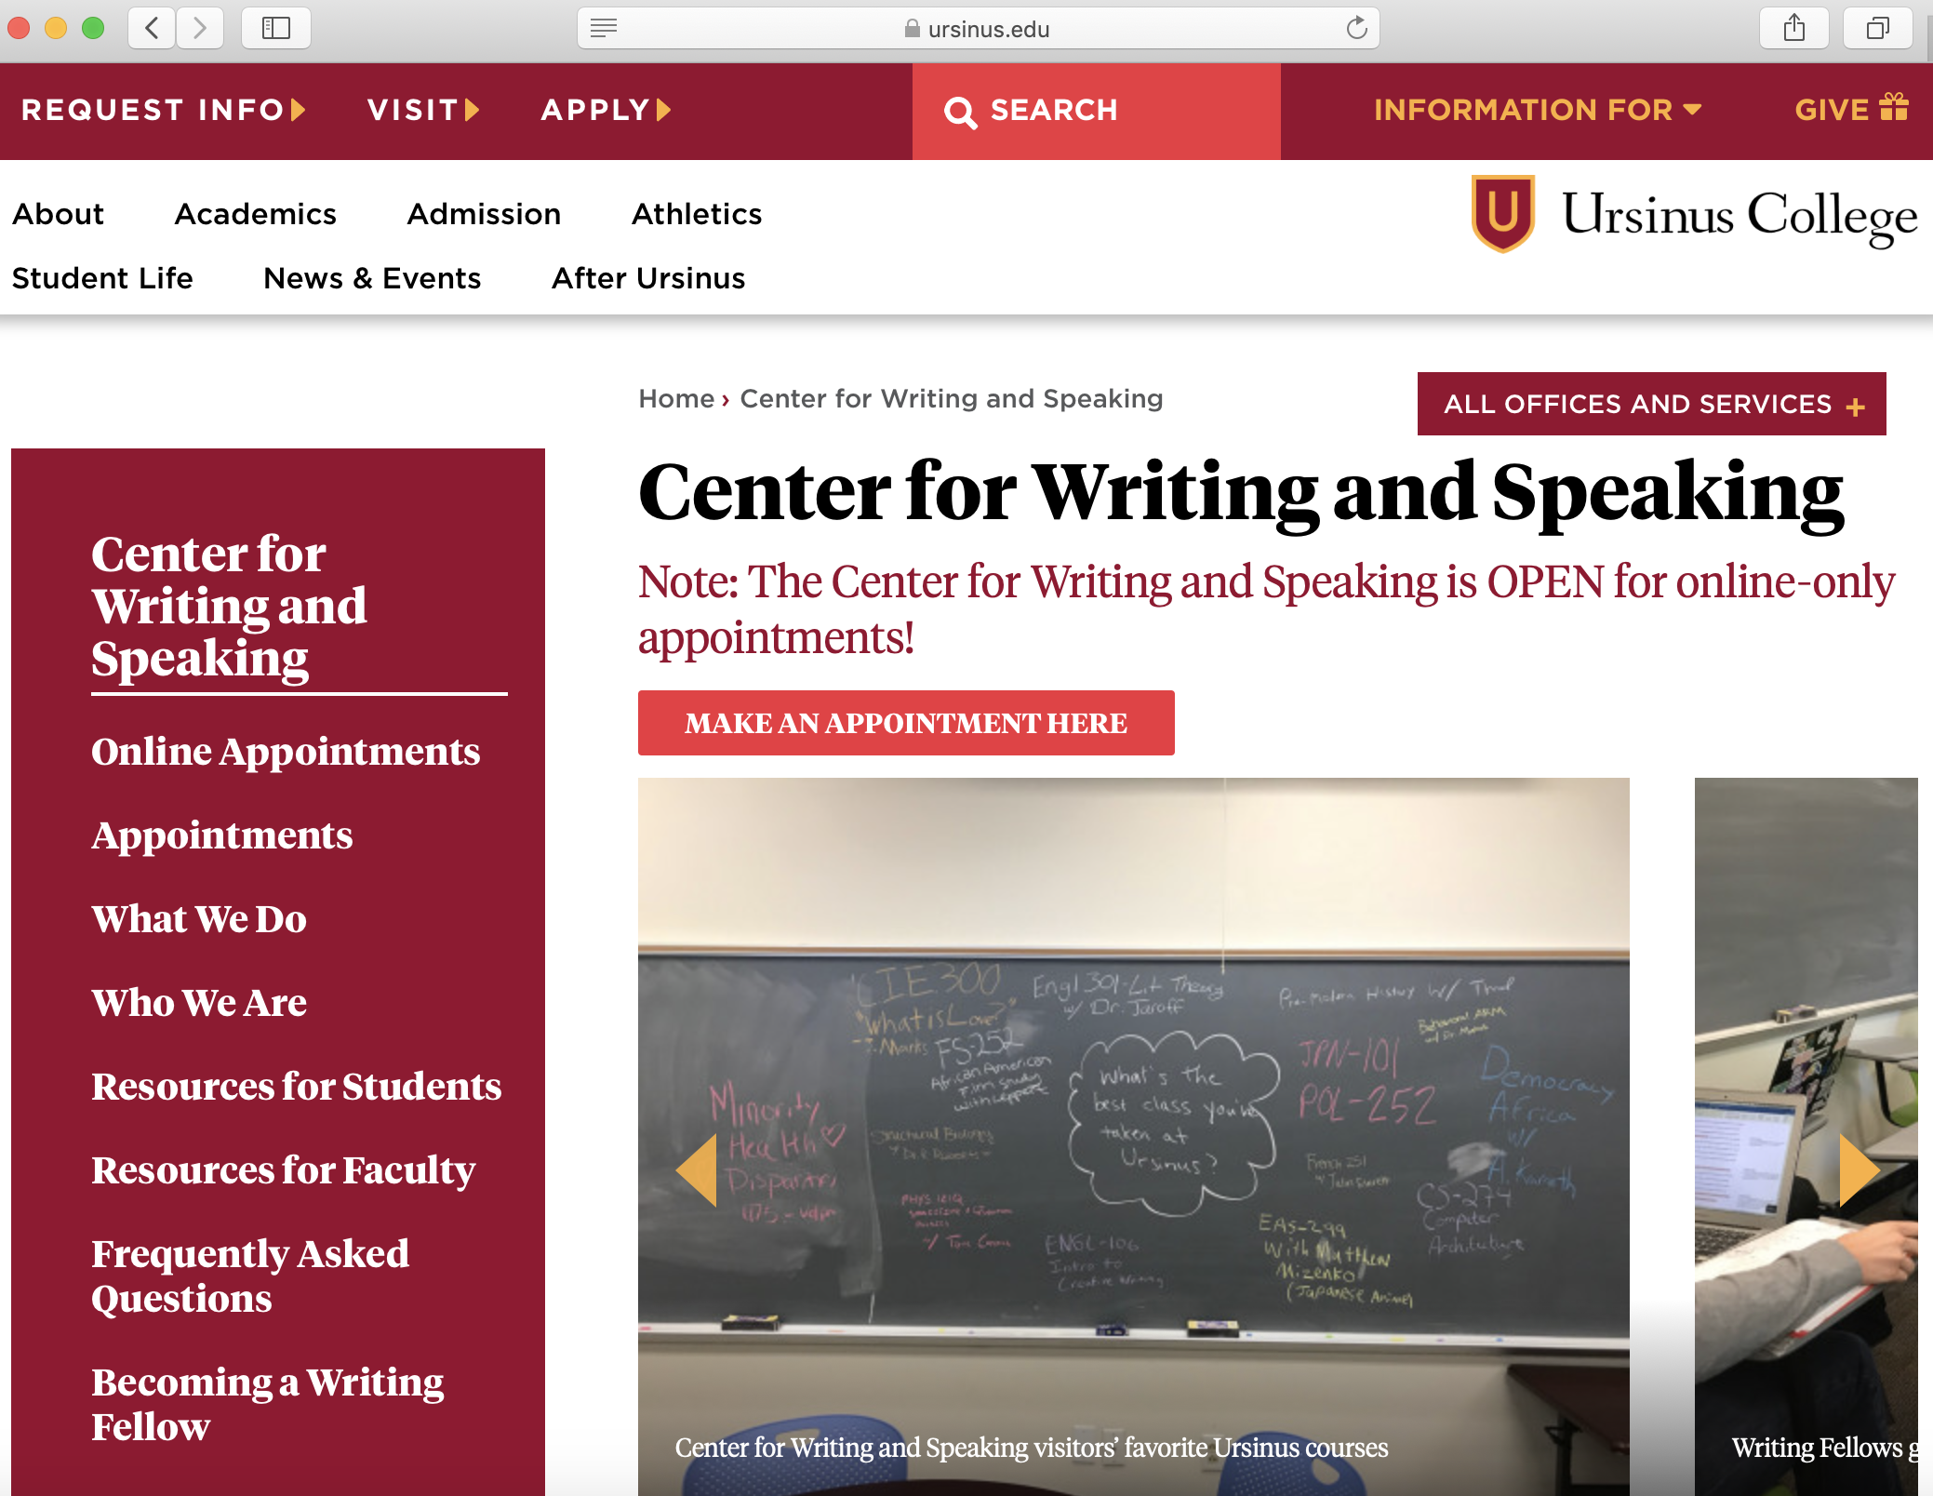
The Ursinus Center for Writing and Speaking
https://www.ursinus.edu/offices/center-for-writing-and-speaking/

