Slide 1

Thesis Statements:
What They Are &
What to Avoid
By Talia Argondezzi and Annalise Koup
To hear audio explanations of this material, click the speaker icon in the lower right corner of each slide

Slide 2

What is a thesis statement?
Summary sentence?
Argument/Claim

Slide 3
Quick Examples of Strong Thesis Statements
Through the negative reaction of the man leaving the cave, Plato’s Allegory of the Cave shows that acceptance of the truth can be painful at first, and some may even reject it in favor of the reality they are more comfortable with, even if they know it is false.
Through the drunken speech of Alicibiades, Plato’s Symposium reveals that Socrates affected not only his students’ minds, but also their hearts; therefore, the debate shows us that no intellectual pursuit is strictly rational.
Medea represents women in a more positive way than Persepolis because Medea shows autonomy and independence while Marjane merely provides support to the dominant men around her.

Slide 4
Thesis Statement Checklist
Concise (one sentence, two max)
Clear (accessible enough to be understood early in the essay)
Specific (avoids vague generalities; shows what the essay is about)
Debatable (a person could reasonably disagree)
Interesting (unexpected; pushes beyond the obvious; insightful)

Slide 5
Thesis Statement Trends to Avoid
obvious
a cliché

Slide 6
What does “obvious” mean?
Statements of fact
(Medea was written by Euripides.)
Wishy-washy observations
(While some might think Medea is a bad person and others that she is good, really she’s a little bit of both.)

Slide 7
What is “a cliché”?
cliché - an idea that is so commonly held and so often repeated, it is no longer considered original or interesting.
Medea shows that what goes around comes around.
Medea shows that friendship is the most important thing in life.
Medea shows that you should stand up for what you believe in.
Avoid these clichés like the plague! ☺

Slide 8
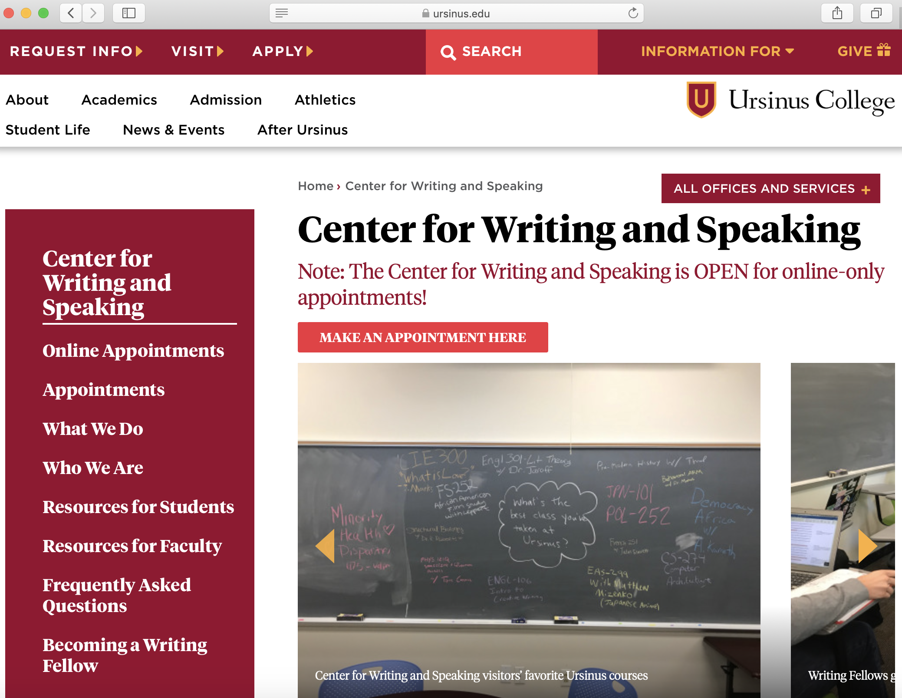
The Ursinus Center for Writing and Speaking
https://www.ursinus.edu/offices/center-for-writing-and-speaking/

