Slide 1


Reading to Write & Annotations
By Carver Wolfe
To play audio for each slide, click play on the white speaker icon in the corner

Slide 2
What is annotating?
Annotation is how the reader can interact with the text
Additive, not just a summary
Examples of annotation styles:
  ask questions
  make personal connections
  paraphrase to better your understanding
  make inferences
  highlight important phrases
  make notes in the margins

Slide 3
1. Preview
Glance around the text before you start
  What does the layout of the text tell you?
  What do you already know about the author or the subject?

Slide 4
2. Annotate
Make your reading thinking-intensive by actively engaging with the text
  Mark up the text with notes, questions, ideas, connections, etc.
  Ask yourself questions as you read

Slide 5
3. Outline, Summarize, and Analyze
The best way to understand the text is to restate it in your own words
Try outlining the text as you go, and summarizing it at the end of the reading

Slide 6
4. Look for repetitions and patterns
If the author uses repetitions or patterns, the information is probably important!
What does the author want you to get from their text?

Slide 7
5. Contextualize
After you finish reading, think about the context of the text. For example, you could ask yourself:
  Why did the author write this?
  What are the text’s historical or cultural significance?
  How does my own experience relate to this text?

Slide 8
6. Compare and Contrast
To further your understanding, you can try comparing it to something else you’ve read in the past, or a textual connection
You can also compare and contrast how the text relates to your life, or make a personal connection

Slide 9
Post-Reading Questions
Spend a few minutes after reading the text answering a few questions:
  The thing that strikes me the most about this is...
  What I found significant, interesting, or relevant was...
  What I understand this to be saying is...

Slide 10
How does this connect to the core questions?
Ask yourself how this text relates to the Ursinus Quest:
  What should matter to me?
  How should we live together?
  How can we understand the world?
  What will I do?

Slide 11
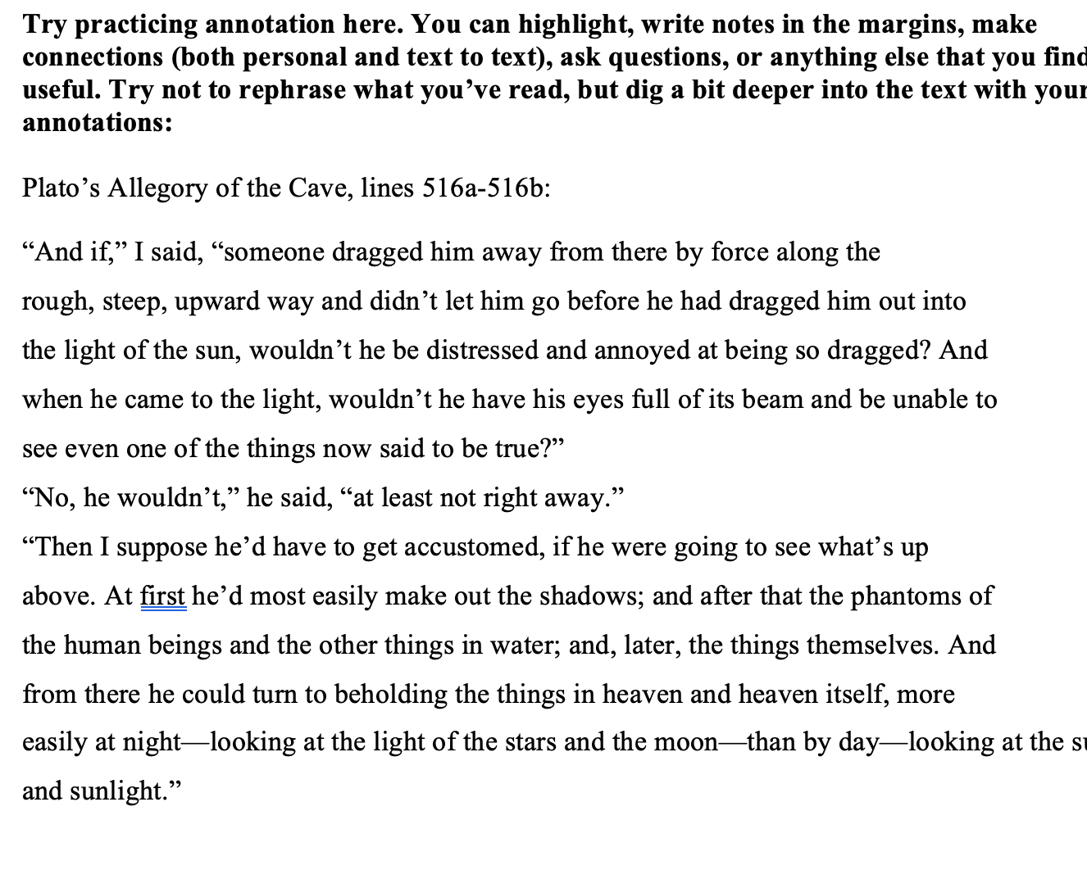
Practice!

Slide 12
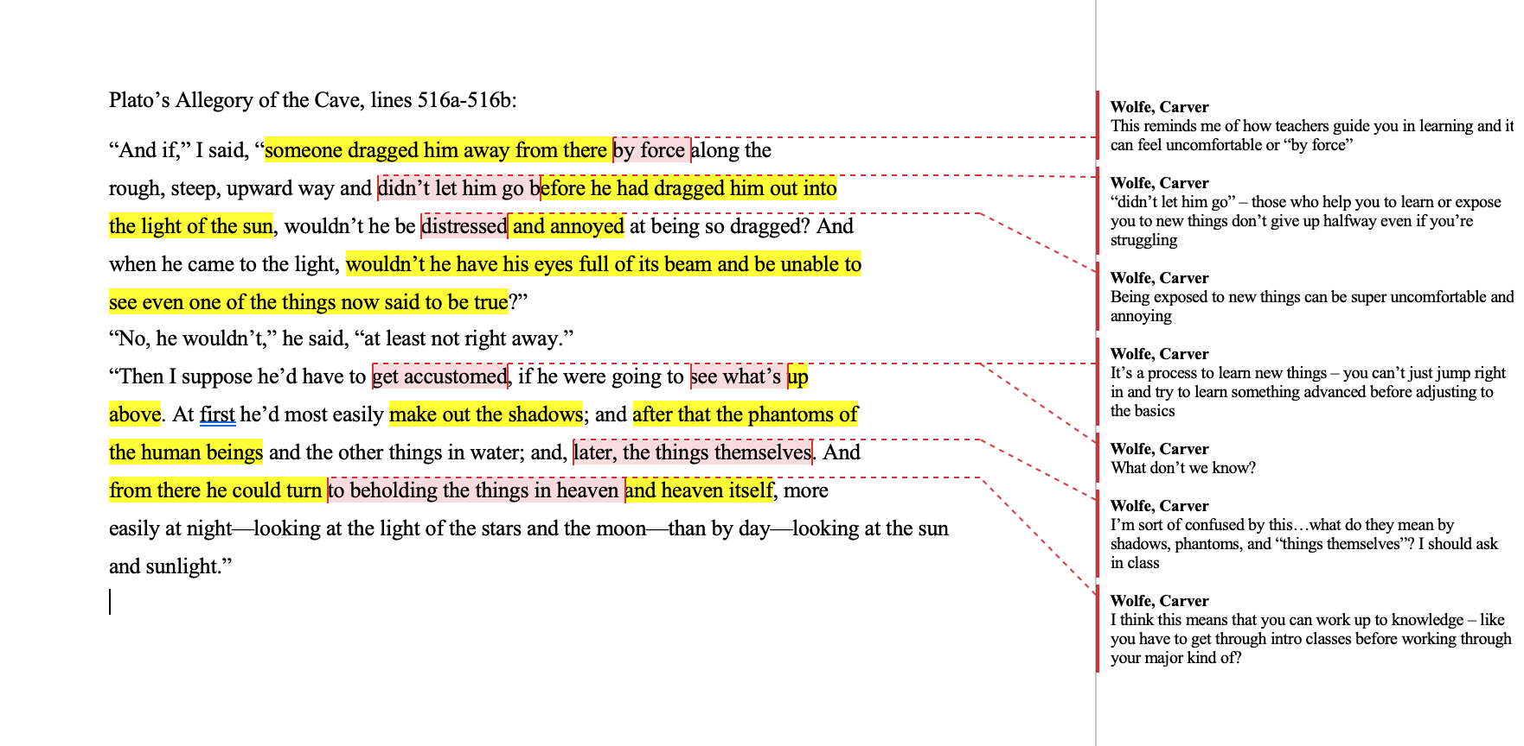
Example of Annotation:

Slide 13

Online Annotations
Apps that can help:
  Epic Pen
  Snipping Tool
  Annotate (Mac)
More information: https://www.ursinus.edu/library/connections-to-teaching-and-learning/tools-technologies/

Slide 14
Sources
https://www.ursinus.edu/library/connections-to-teaching-and-learning/tools-technologies/
https://guides.library.harvard.edu/sixreadinghabits
The Curious Writer by Bruce Ballenger

