Slide 1
Perfecting Your Thesis Statement
Dr. Talia Argondezzi

Slide 2
Introductions Should Include
A hook, to interest your reader
A sense of the intellectual stakes of the essay: What problems will be considered? What conversation or debate is this essay entering?
A thesis statement

Slide 3
What’s the Difference?
Weaker Thesis Statements
Strong Thesis Statement
This paper will compare and contrast two pizza places.
Pepper’s and Amante are similar in some ways and different in others.
Pepper’s and Amante are similar in many ways, but they have one major difference.
Pepper’s and Amante both offer a greater variety of ingredients than other Chapel Hill/Carrboro pizza places (and than any of the national chains), but the funky, lively atmosphere at Pepper’s makes it a better place to give visiting friends and family a taste of local culture.

Slide 4
Good thesis statement checklist
Concise (one sentence, two max)
Clear (accessible enough to be understood early in the essay)
Specific (avoids vague generalities; shows what the essay is about)
Debatable (a person could reasonably disagree)
Interesting (unexpected; pushes beyond the obvious; insightful)
Pause for Exercises 1 and 2.

Slide 5
Strategies for Infusing Your Thesis Statement with Insight

Slide 6
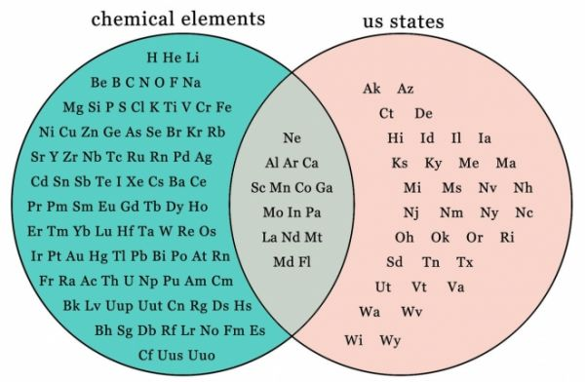
Insight Strategy
Point out a similarity between two things that seem really different at first.
As a small suburban liberal arts college, Ursinus would appear to have little in common with Columbia University, with its large population, urban campus, and international reputation. But their shared interest in a common “Great Works” course taken by all freshmen is the cause of the tightknit communities at both schools.
Although Cypher appears to be the villain because he betrays the cause, both he and Neo are ultimately motivated by self-interest.

Slide 7

Insight Strategy
Point out a key difference between things that seems similar.
Both Gene and Laura are professors who teach two classes per semester, but because Laura’s two classes have 50 students each and are writing intensive, her workload is substantially heavier.
Both the cave dwellers and Neo leave their darkness to discover new insights; however, the process of enlightenment in Plato’s allegory is painful and lonely compared to the fun and companionship depicted in The Matrix.

Slide 8
Insight Strategy
Point out an underlying assumption or unproven premise.
The argument that women are simply “programmed” to nurture their children is based on biology alone and neglects the fact that human behavior is socially constructed.
Those who would call Medea insane overlook her lack of options. Euripides’s audience would know that any of the “sane” measures today’s woman might take were unavailable to Medea.

Slide 9

Insight Strategy
Point out something that is true and accurate, but that others would not necessarily think of.
Seek ideas that are not immediately apparent, but only emerge after deeper reflection.
While Judy seems to be a mindless “yes” person, simply constantly agreeing with everyone, she subtly interjects dissent and disagreement when she hesitates before she agrees.
Although Neo appears to be the hero of the film, in fact all his successes are accidental. Instead the clear-eyed vision and faith of Trinity, the Oracle, and Morpheus ultimately save the world.

Slide 10
Pause
for Exercise 3

Slide 11
How can we improve these theses?
This essay will address representations of gender in The Matrix and Medea.
Gender is represented in The Matrix and Medea in some similar but in some different ways.
Although they are very different sorts of texts, The Matrix and Medea both show ambivalent and frequently negative attitudes toward women.
Both The Matrix and Medea suggest that women are inferior to men, but they differ in what they think men’s roles in society should be.

Slide 12

Strong Thesis Statement
Medea represents women in a more positive way than The Matrix because Medea shows autonomy and independence while Trinity merely provides support to the dominant men around her.
Pause for Exercise 4

Slide 13
The Center for Writing and Speaking
https://www.ursinus.edu/offices/center-for-writing-and-speaking/

Slide 14
SOURCES
Sample thesis statements come from University of North Carolina Chapel Hill’s online Writing Center (the pizza ones) and Indiana University’s online Writing Tutorial Services (the banana tree herb supplement and Appalachian hunger ones).

